Slide 1
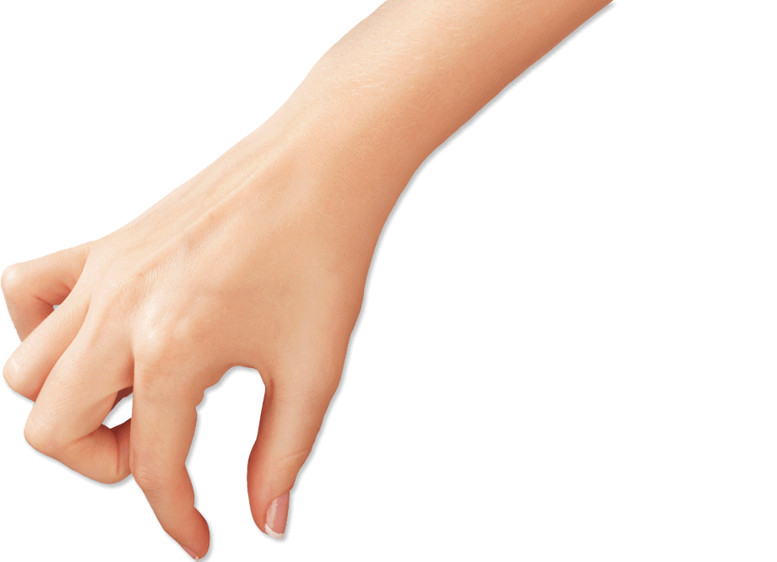
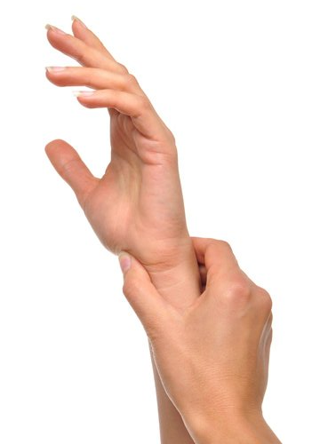
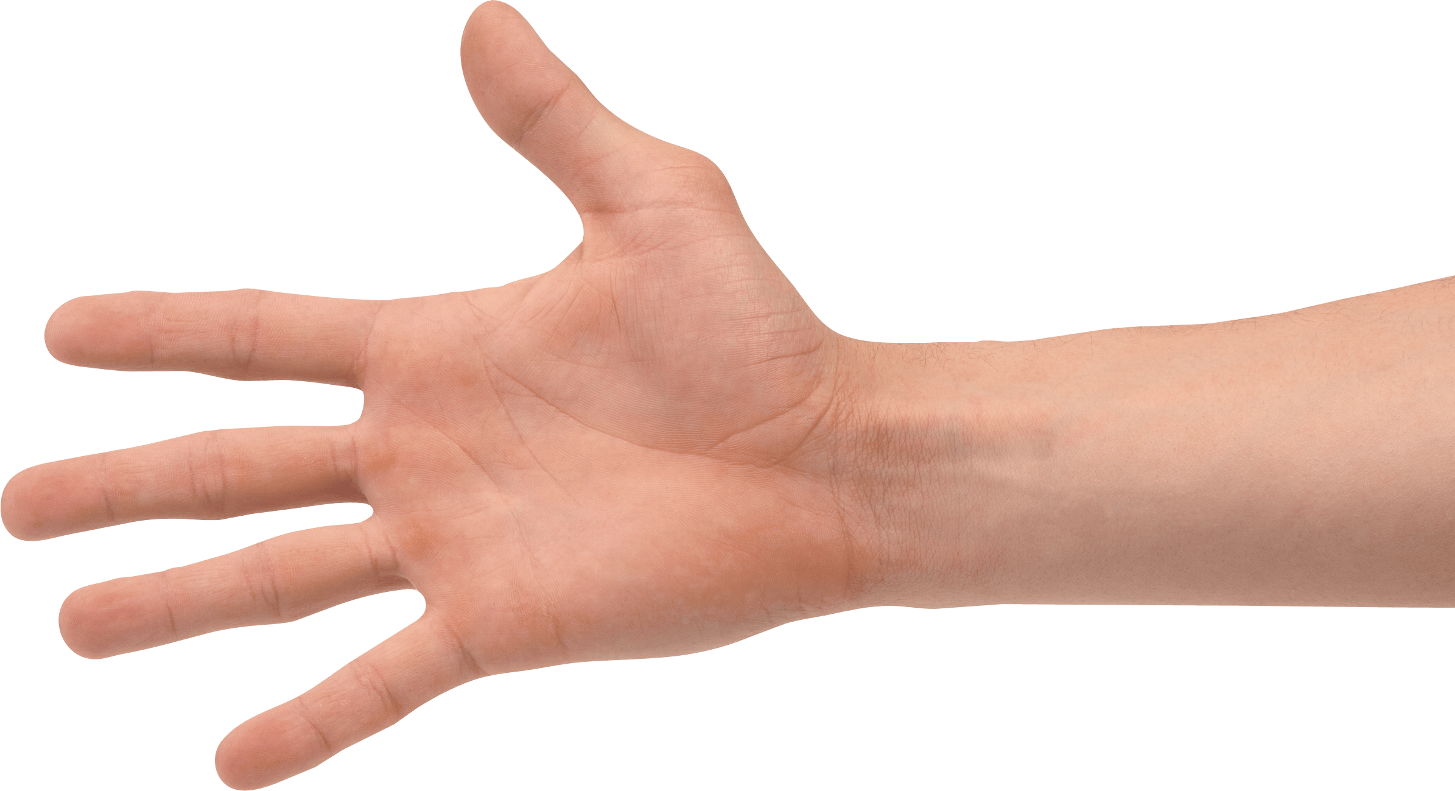
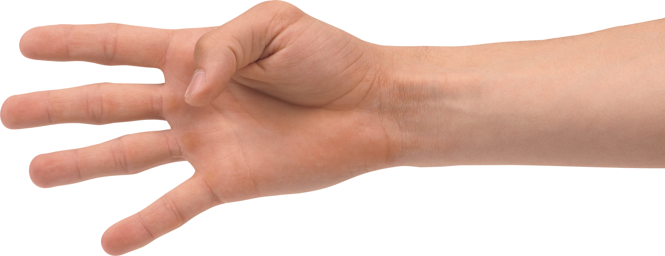
Toward a System to aid communication with Deaf
Notes:
there are serval ways for communication , we can talk, we can write our messages in our paper and also we can use some devices like phone, computer and … for communicating.
One of major communication system is ICT (Information and Communications Technology) .

Slide 2

ICT
In our modern information and communication society, daily life would be unthinkable without technology.
Information and Communications Technology (ICT) is also very useful for people with special needs.
Notes:
We qll use use technology for deferent things like communicating, searching information, creating slide shoe for our presintaion
Like people who cant hear,talk,see ,certain helth problem
the technology is useful for them.

Slide 3
Who are Deaf?
Deaf are people who can’t talk and hear,
hearing people are unfamiliar with deaf people's Because they don’t know their language.

Slide 4
How they communicate?
Hearing people think that if you cannot hear, you can easily access any necessary information by simply reading it in written form, and if you really need to communicate, you can always write your message down. [5]
deaf have their own language of communication (sign language)
They write and read Faster on sign writing.
Notes:
Hearing people think that if you cannot hear, you can easily access any necessary information by simply reading it in written form, and if you really need to communicate, you can always write your message down. [5]
But this system is not an efficient way to communicate, deaf have their own language of communication (sign language), they can only understand this language and also they write and read Faster on sign writing.
Sign languages are languages that use the visual-manual modality to convey meaning
Sign writing is the writing form for sign language like in English we have alphabets like A B C in sign language also we have some alphabet that represent signs.

Slide 5
What is the main problem?
According to survey in 2015, there are 121 “deaf sign languages” in the world. But there is not such an efficient mechanism where deaf can easily understand people thoughts.[3]

Slide 6
Impact of the problem:
Deaf are losing their moral, and there is a huge gap between deaf and normal people, they don’t know how to understand each other feelings and messages.
Deaf don’t have access to facilities and opportunities as much as normal people.

Slide 7
Why I told you these information?
My final project as a computer science student
Research on deaf communication system
“Toward a System to aid communication with deaf”

Slide 8
What is our goal?
We will suggest an efficient mechanism that deaf can easily communicate with normal people to understand their thoughts.
As deaf is a part of society and they need to make a connection with people around them.

Slide 9
Expected Outcomes
We will have a brief analysis of deaf communication systems.
we will suggest an effective mechanism that can be efficient in deaf communication.
We will describe how technology can facilitate this mechanism

Slide 10
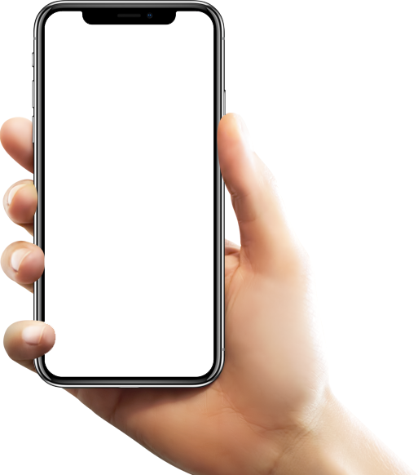
What is our solution?
An mobile App that can translate people thoughts to sign language in real time.
There will be an 3d character in mobile and it will react on everything that it will hear, and do its sign

Slide 11
A little bit technical:
Artificial Intelligence
Have you ever seen google translator?
Machine Translation
Translate sentences (not word by word)!
How it work:
as an example:5 English books,5 Persian book
The system will read it and learn the language by it self.
Notes:
You didn’t need to tell the computer the meaning of every world or the grammar roles, the computer will learn it by him self. The only think you need is a computer a little bit knowledge of artificial inelegance (Machine Learning ) and the data (Book)

Slide 12
A little more technical:
Same as google translator we use Artificial Intelligence to translate people thoughts to sign Language.
1:convert Sounds to text using built-in mobiles feature
2:convert the text to sign writing using Machine translation
3:do the animation
Notes:
You didn’t need to tell the computer the meaning of every world or the grammar roles, the computer will learn it by him self. The only think you need is a computer a little bit knowledge of artificial intelligence (Machine Learning ) and the data (Book)

Slide 13
Sign writing?
It’s the international writing form for sign Language which cover every sign.
Assign animation for Every character in sign writing
񌏁񍝁 񀀒* \
Notes:
So first we will create a data set where we will write the sign writing for English words manually then we will use artificial intelligence or machine translation or machine learning to train the system ones the system learned to “how convert English to sign writing” we will create animation for every character of sign writing.
So our application will have the power to hear our thoughts convert it to sign writing and do its ???? Sign using a 3d character. ☺

Slide 14
Thank You!

